Slide 1


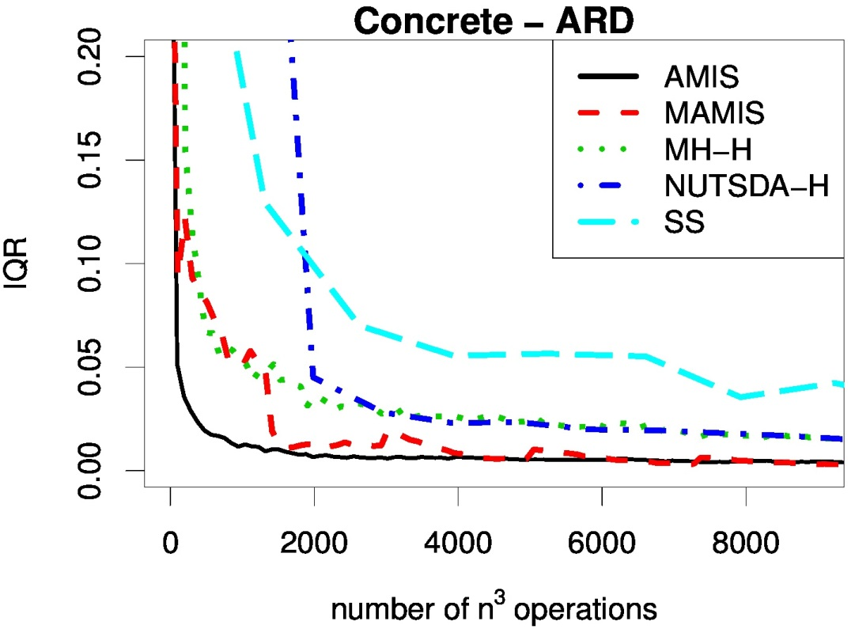
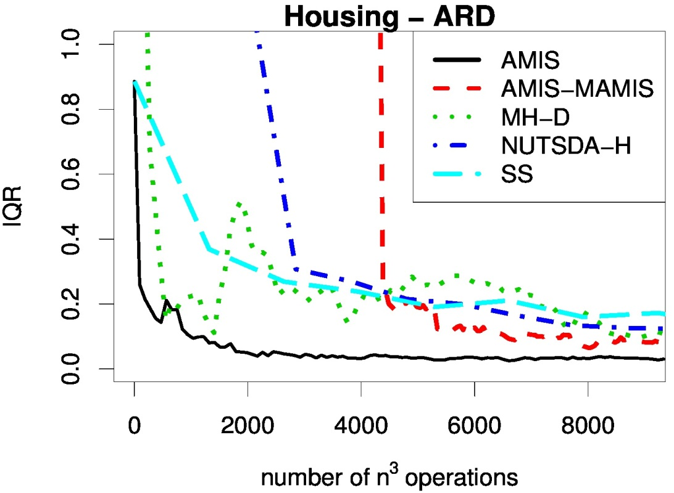
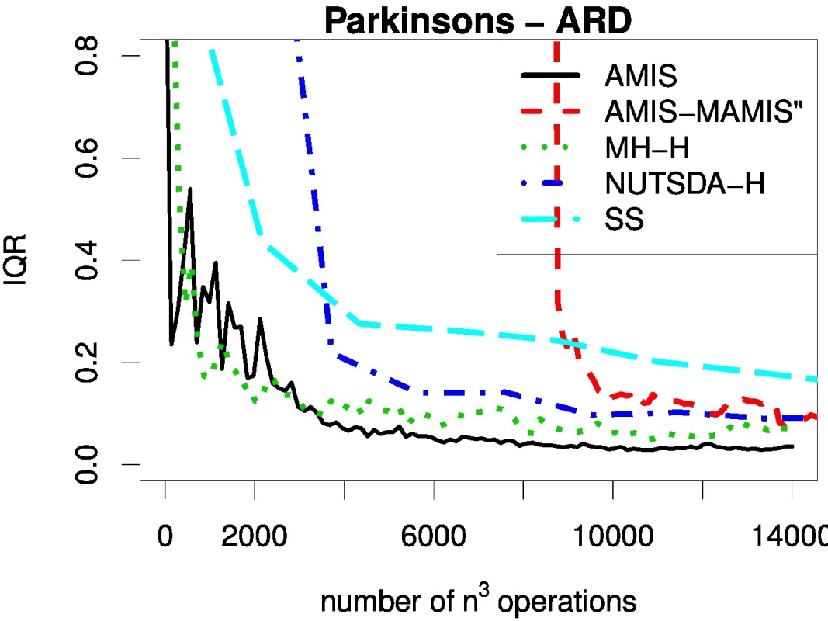
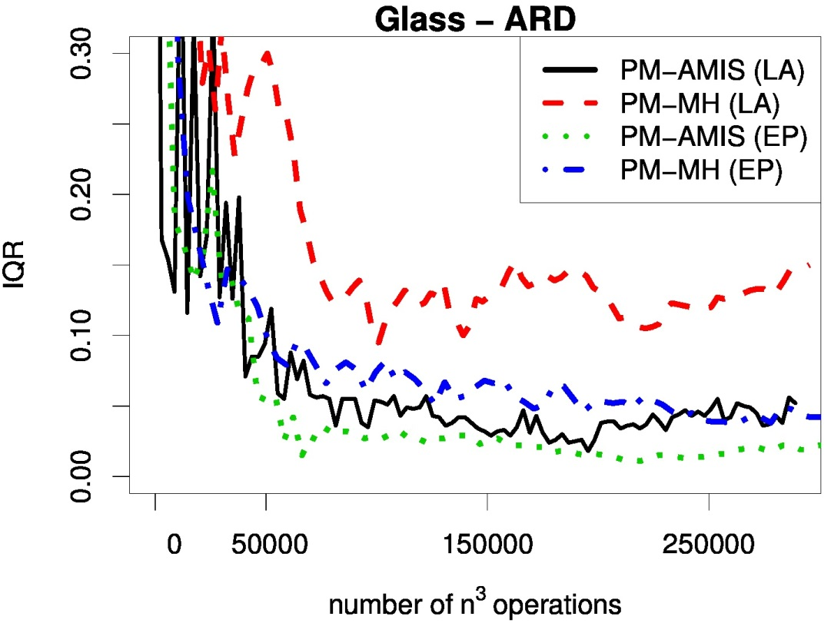
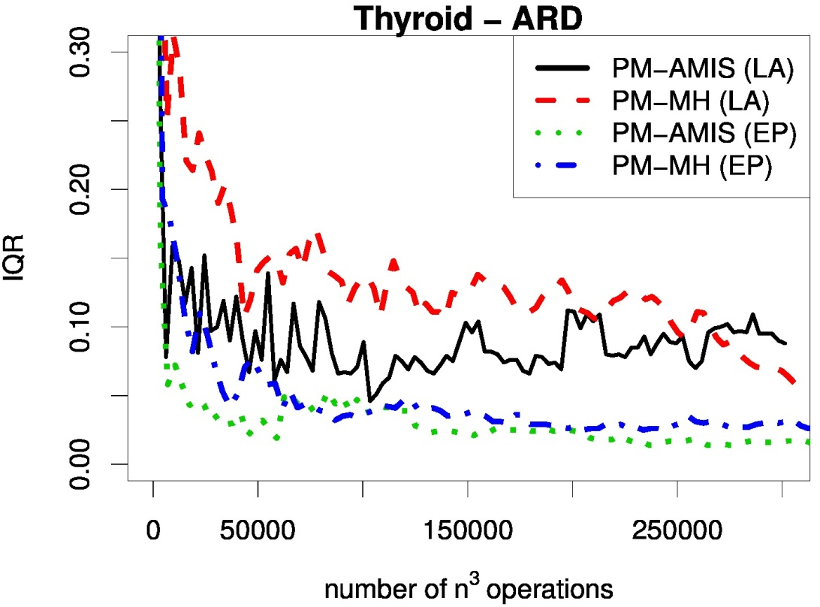
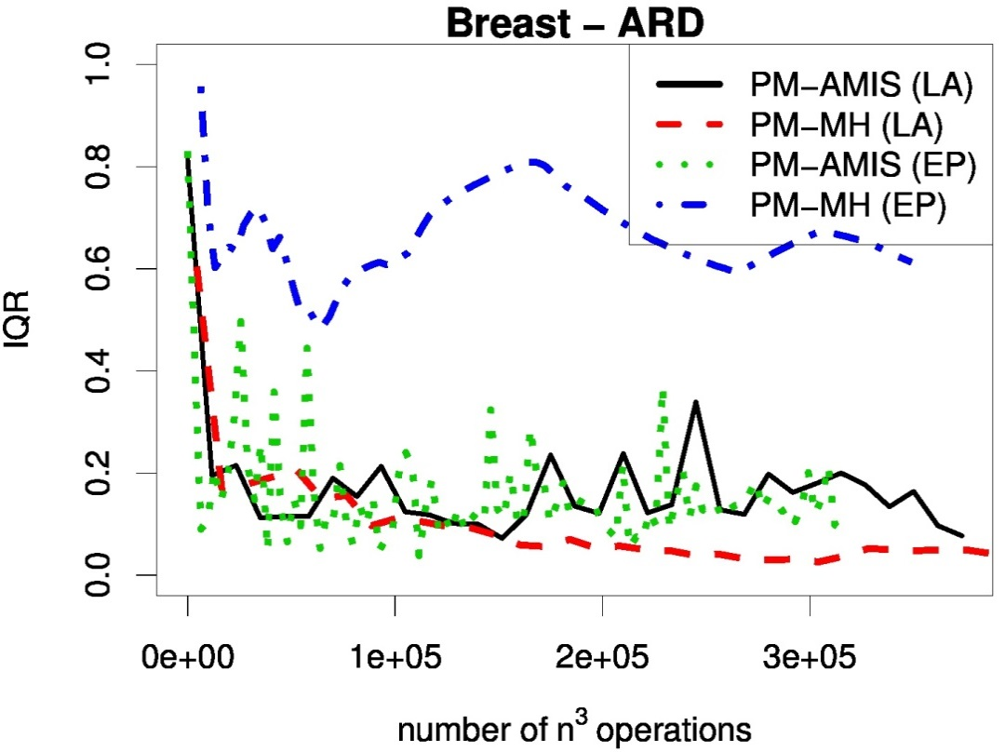
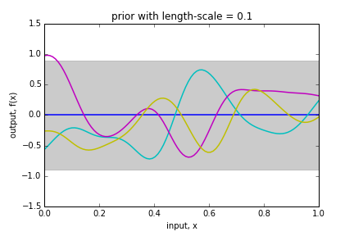
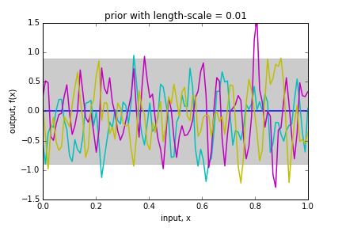
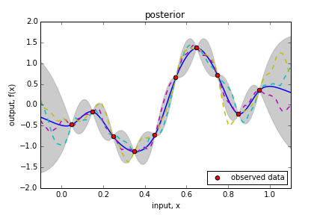
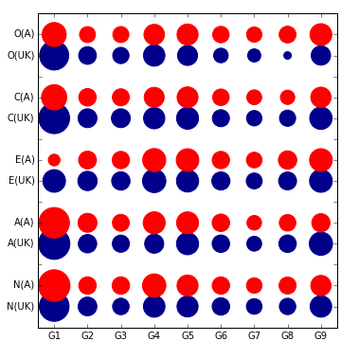
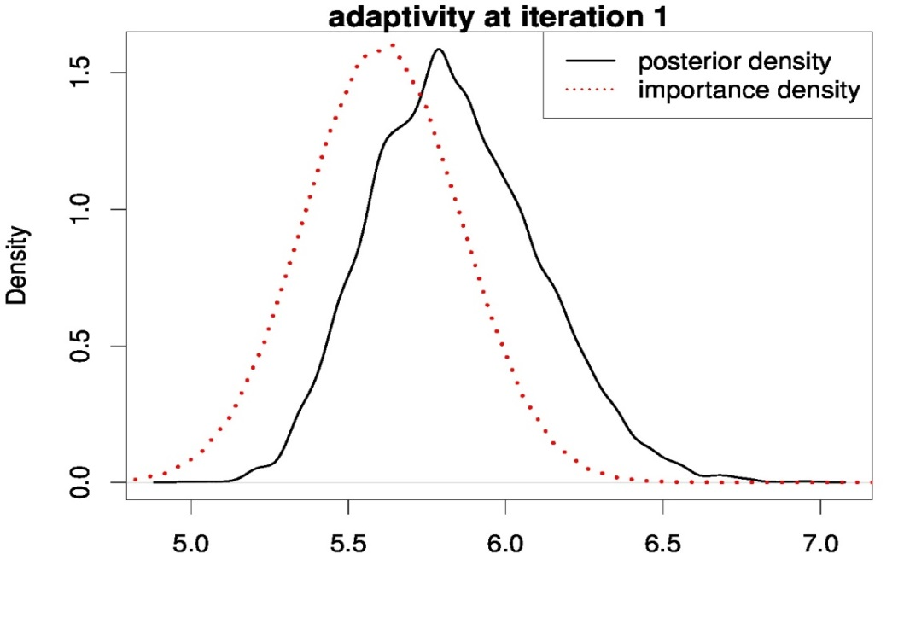
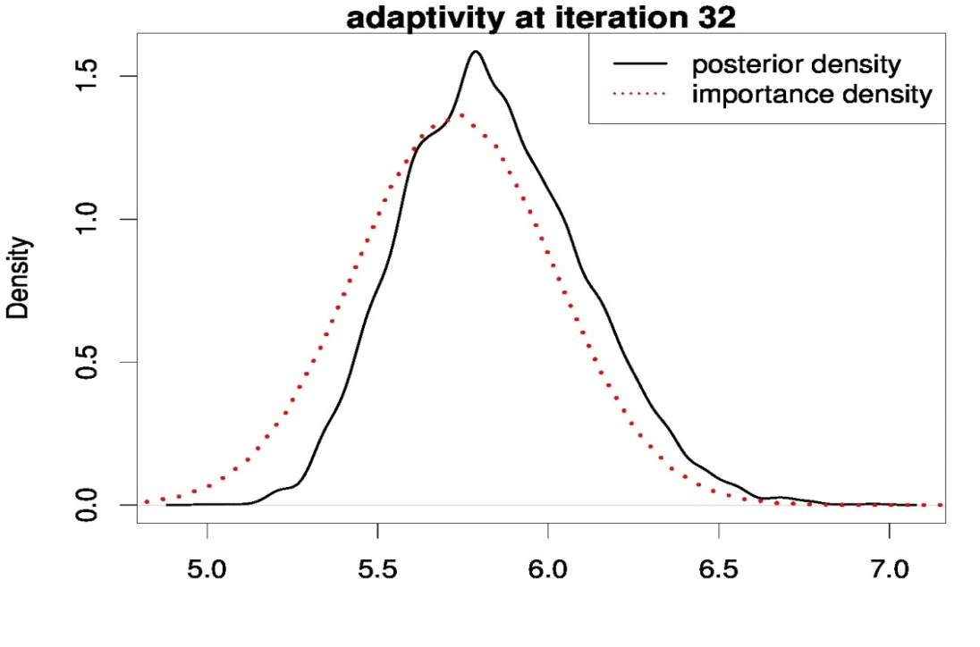
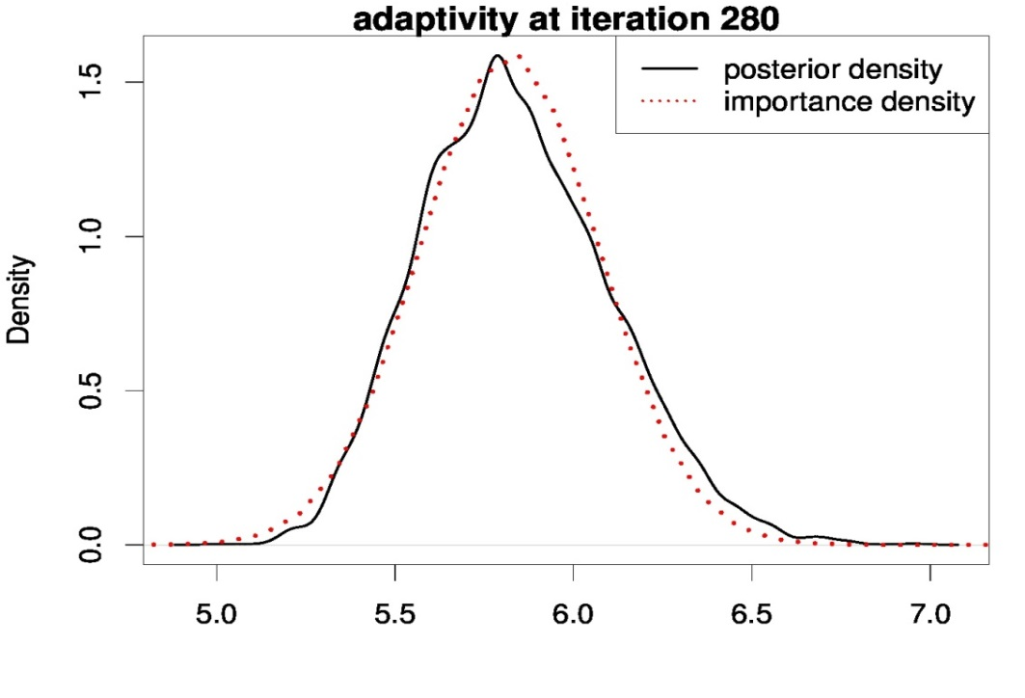
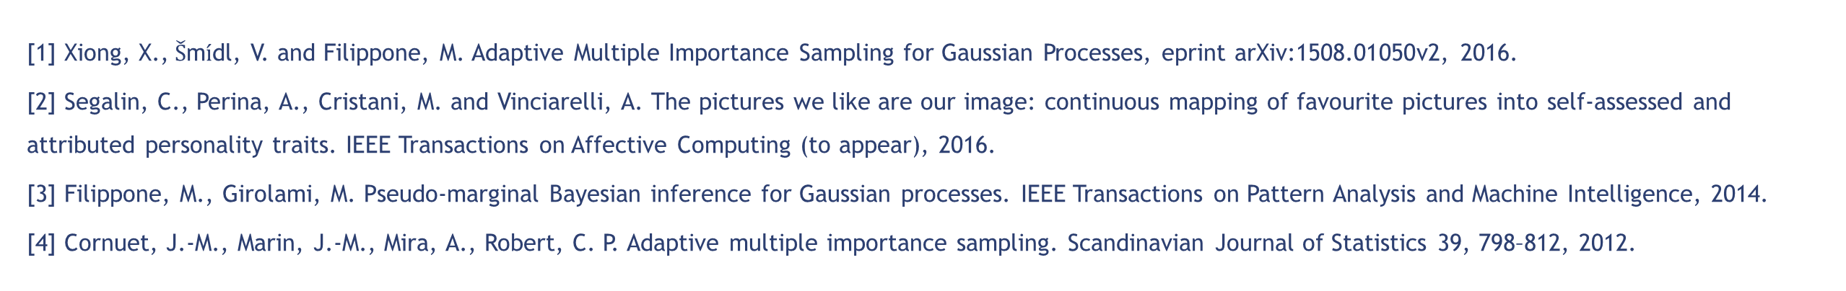
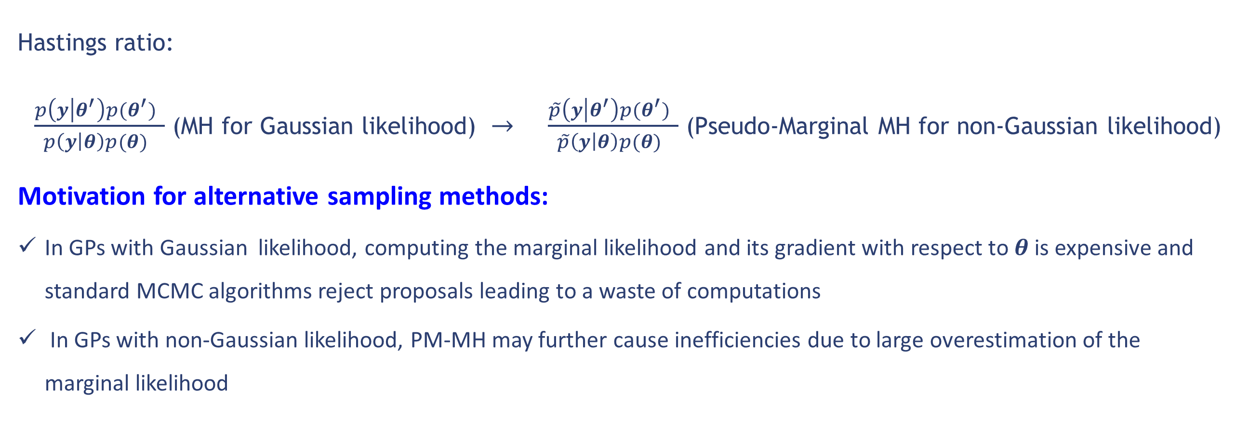
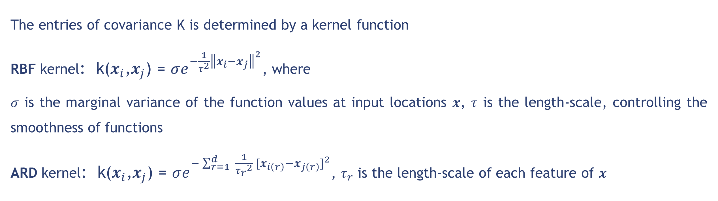
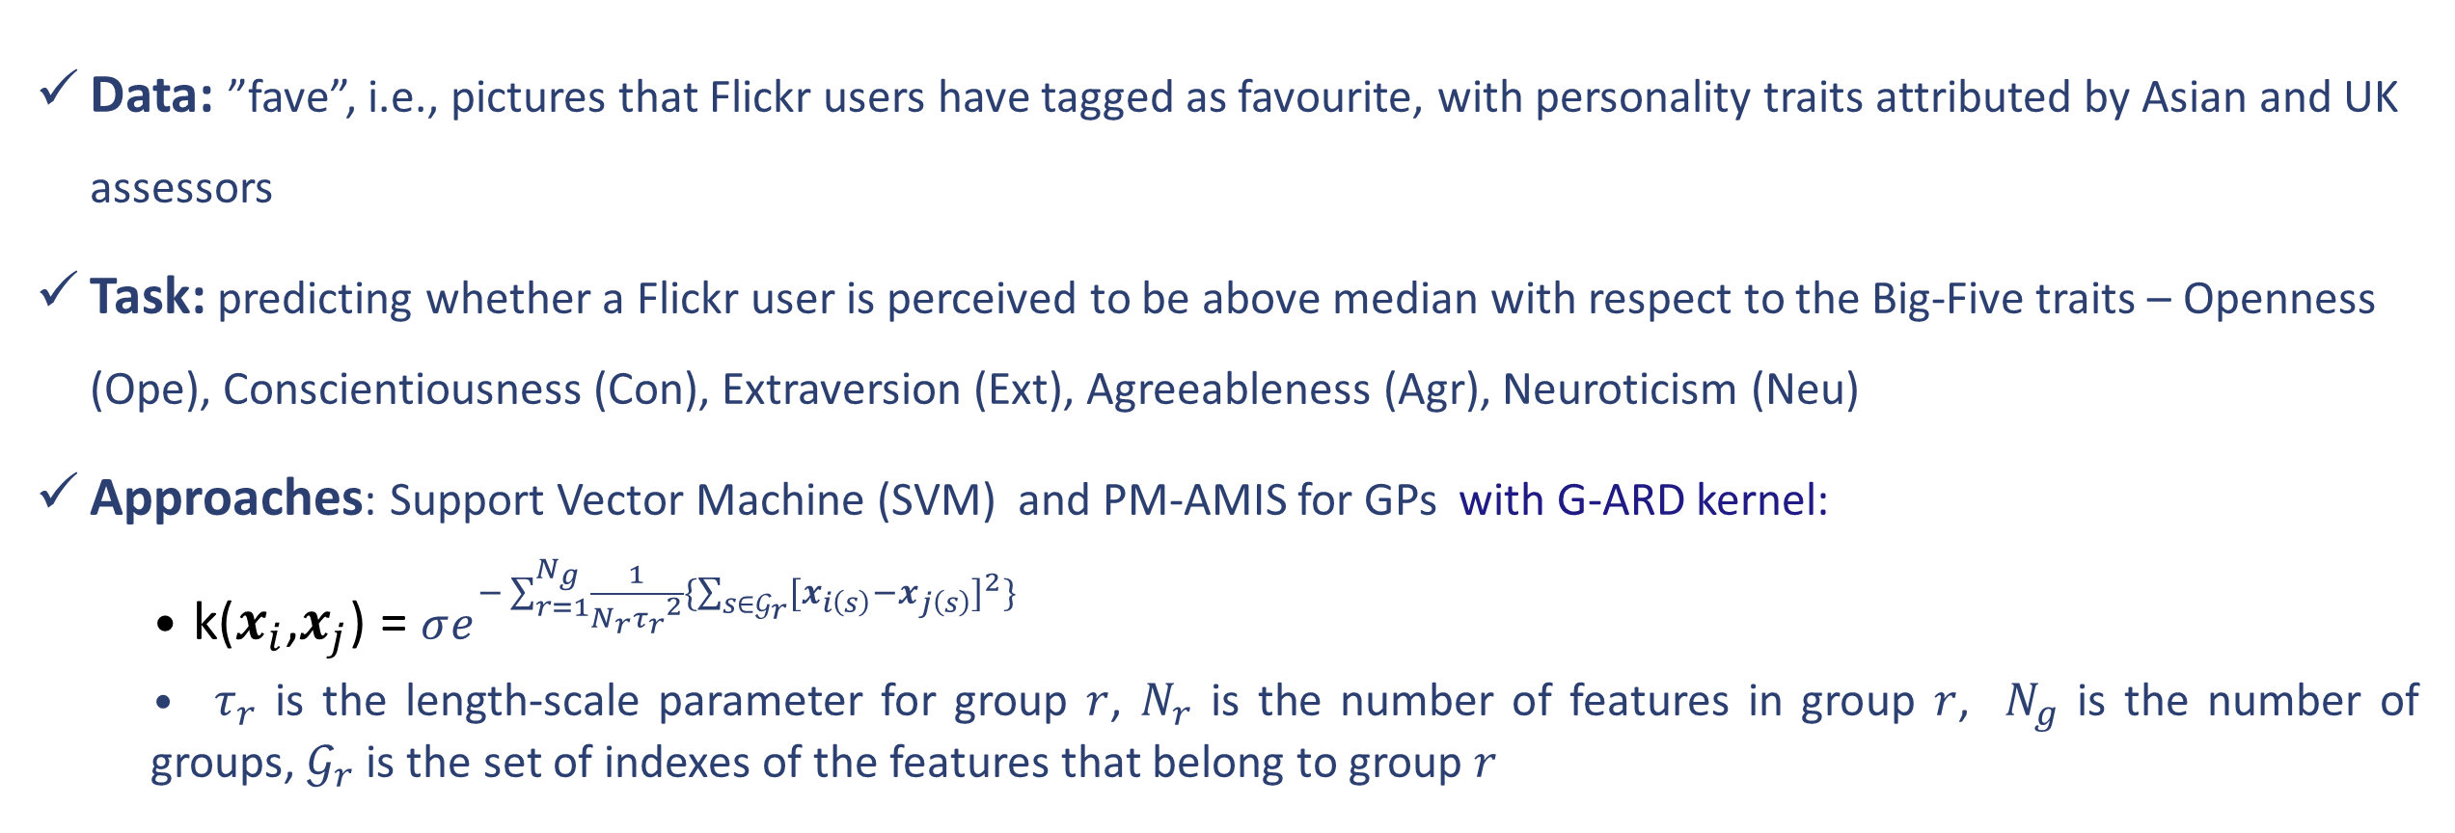
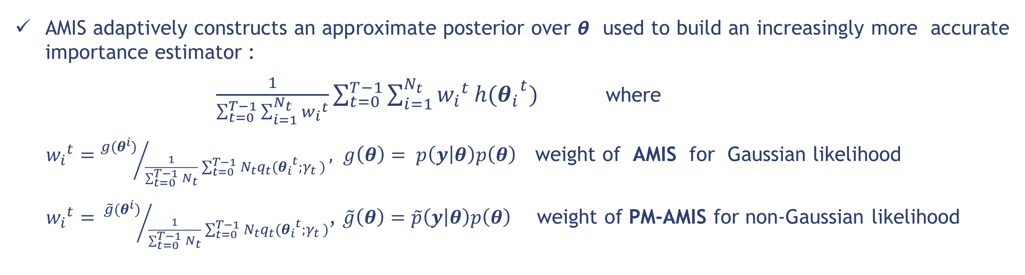
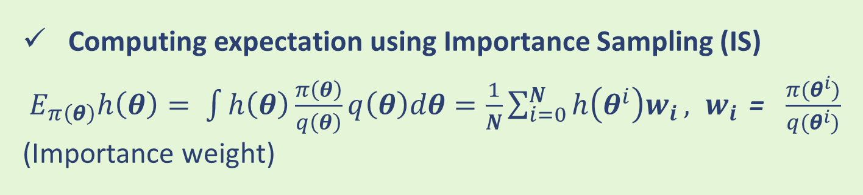
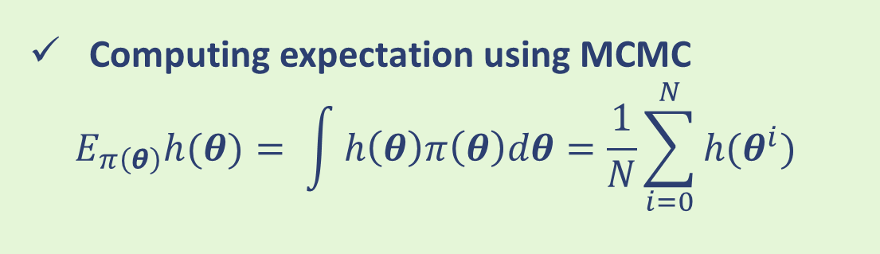
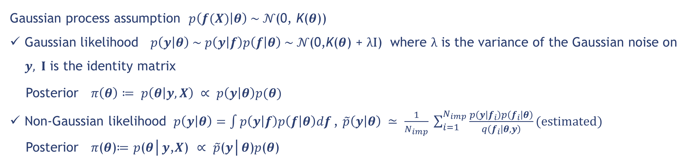
Adaptive Multiple Importance Sampling for Gaussian Processes:
Finding Difference Makers in Personality Impressions
Xiaoyu Xiong¹, Maurizio Filippone², Alessandro Vinciarelli¹
1-The University of Glasgow email: x.xiong.1@research.gla.ac.uk, Alessandro.Vinciarelli@glasgow.ac.uk
2- EURECOM, Sophia Antipolis, France email: maurizio.filippone@eurecom.fr
Motivation
Experiments
Traditional parametric approaches for Social Signal Processing (SSP):
falls short in taking into account uncertainty due to model misspecification or overfitting
Current solutions: Bayesian treatment with nonparametric models like Gaussian Processes (GPs)
GPs requires accurately characterizing posterior over covariance parameters:
this is normally done by means of Markov chain Monte Carlo (MCMC) methods
However, MCMC for learning GP parameters are inefficient due to its rejection of expensive proposals
In this work, we propose an alternative inference framework for GPs based on Adaptive Multiple Importance Sampling (AMIS).
The experimental results suggests AMIS is competitive with MCMC for GP models and suitable for SSP
IQR: Interquartile Range of the expectation of the norm of the parameters
Convergence analysis: IQR against computational costs (number of n^3 operations)
GP regression - AMIS vs MH, Best of HMC family, slice sampling (SS)
Bayesian Gaussian processes
Gaussian process assumption $p\left(f(X) | θ\right) \sim 𝒩\text{(}\text{0}\text{, }\text{K}\text{(}θ\text{)}$)
Gaussian likelihood$p\left(y | θ\right) \sim p\left(y | f\right)p\left(f | θ\right) \sim 𝒩\text{(}\text{0}\text{,}\text{K}\text{(}θ\text{)}\text{ + }λ\text{I}\text{)}$ where λ is the variance of the Gaussian noise on $y$, $I$ is the identity matrix
Posterior $π\left(θ\right)≔ p\left(θ | y,X\right) ∝ p\left(y | θ\right)p(θ)$
Non-Gaussian likelihood $p\left(y | θ\right)=\int{p\left(y | f\right)p\left(f | θ\right)df}\text{,} \tilde{p}\left(y | θ\right) ≃ \frac{1}{N_{imp}} \sum_{i=1}^{N_{imp}}{\frac{p\left(y | f_{i}\right)p\left(f_{i} | θ\right)}{q\left(f_{i} | θ,y\right)}}(estimated)$
Posterior 𝜋(𝜽)≔ 𝑝(𝜽│𝒚,𝑿) ∝ $\tilde{p}$(𝒚│𝜽)𝑝(𝜽)
GP classification - PM-AMIS vs PM-MH
Application of PM-AMIS for GPs: Personality inference from Flickr images
Data: ”fave”, i.e., pictures that Flickr users have tagged as favourite, with personality traits attributed by Asian and UK assessors
Task: predicting whether a Flickr user is perceived to be above median with respect to the Big-Five traits – Openness (Ope), Conscientiousness (Con), Extraversion (Ext), Agreeableness (Agr), Neuroticism (Neu)
Approaches: Support Vector Machine (SVM) and PM-AMIS for GPs with G-ARD kernel:
k($x_{i}$,$x_{j}$) = $σe^{−\sum_{r=1}^{N_{g}}{\frac{1}{{N_{r}τ_{r}}^{2}}}\{\sum_{s∈𝒢_{r}}{{{[x}_{i\left(s\right)}−x_{j\left(s\right)}]}^{2}\}}}$
${ τ}_{r}$ is the length-scale parameter for group $r$, $N_{r}$ is the number of features in group $r$, $N_{g}$ is the number of groups, $𝒢_{r}$ is the set of indexes of the features that belong to group $r$
The entries of covariance K is determined by a kernel function
RBF kernel: k($x_{i}$,$x_{j}$) = $σe^{−\frac{1}{τ^{2}}{\left\|x_{i}−x_{j}\right\|}^{2}}$, where
$σ$ is the marginal variance of the function values at input locations $x$, $τ$ is the length-scale, controlling the smoothness of functions
ARD kernel: k($x_{i}$,$x_{j}$) = $σe^{−\sum_{r=1}^{d}{ \frac{1}{{τ_{r}}^{2}} {[x_{i\left(r\right)}−x_{j\left(r\right)}]}^{2}}}$, $τ_{r}$ is the length-scale of each feature of $x$
Table 1: Groups of features (number in brackets denotes the number of features for each group )
Inference in GPs is about learning the kernel parameters, e.g.,$θ$ = ($σ, τ$) (RBF) or $θ$ = ($σ,τ_{r}$) (ARD)
G1 | G2 | G3 | G4 | G5 | G6 | G7 | G8 | G9
Faces (1) | Colour Properties(3) | Colour Distribution(1) | Homogeneous Regions (4) | Composition (2) | Texture Wavelets (12) | GIST filters (24) | GLCM (24) | Texture Statistics (4)
Computing expectation using MCMC
$$E_{π\left(θ\right)}h(θ)= \int{h\left(θ\right)π\left(θ\right)dθ}=\frac{1}{N}\sum_{i=0}^{N}{h(θ^{i}) }$$
Computing expectation using Importance Sampling (IS)
${ E}_{π\left(θ\right)}h\left(θ\right)= \int{h\left(θ\right)\frac{π\left(θ\right)}{q\left(θ\right)}q\left(θ\right)dθ}=\frac{1}{N}\sum_{i=0}^{N}{h\left(θ^{i}\right)w_{i}}, w_{i}$ = $\frac{π(θ^{i})}{q(θ^{i})}$ (Importance weight)
Results:
PM-AMIS for GPs achieves comparable accuracies with SVM (see Table 2)
G-ARD is able to identify the groups of features (G1, G5, G9, G4) that mostly influence personality impression
Weights difference (Figure 1) across Asian and UK personality assessors suggests cultural difference on personality perception
MCMC for learning $θ$
Hastings ratio:
$\frac{p\left(y | θ^{′}\right)p(θ^{′}) }{p\left(y | θ\right)p(θ) }$ (MH for Gaussian likelihood) $→$ $\frac{\tilde{p}\left(y | θ^{′}\right)p(θ^{′}) }{\tilde{p}\left(y | θ\right)p(θ) }$ (Pseudo-Marginal MH for non-Gaussian likelihood)
Motivation for alternative sampling methods:
In GPs with Gaussian likelihood, computing the marginal likelihood and its gradient with respect to $θ$ is expensive and standard MCMC algorithms reject proposals leading to a waste of computations
In GPs with non-Gaussian likelihood, PM-MH may further cause inefficiencies due to large overestimation of the marginal likelihood
Figure 1: Coefficients of the G-ARD for the five traits (O, C, E, A, N) and two cultures Asian (A) and UK
Table 2: Prediction Accuracy
 | Ope | Con | Ext | Agr | Neu
PM-AMIS for GPs (UK) | 65% | 58% | 71% | 73% | 79%
SVM(UK) | 59% | 62% | 71% | 74% | 77%
PM-AMIS for GPs (Asia) | 68% | 52% | 74% | 68% | 69%
SVM(Asia) | 68% | 47% | 68% | 69% | 70%
Adaptivity of AMIS
Conclusions
AMIS adaptively constructs an approximate posterior over 𝞱 used to build an increasingly more accurate importance estimator :
$\frac{1}{\sum_{t=0}^{T−1}{\sum_{i=1}^{N_{t}}{{w_{i}}^{t}}}}\sum_{t=0}^{T−1}{\sum_{i=1}^{N_{t}}{{w_{i}}^{t}}h({θ_{i}}^{t}})$ where
${w_{i}}^{t}={g(θ^{i})}/{\frac{1}{\sum_{t=0}^{T−1}{N_{t}}}\sum_{t=0}^{T−1}{N_{t}q_{t}({θ_{i}}^{t};γ_{t}} )}, g\left(θ\right)= p\left(y | θ\right)p\left(θ\right)$ weight of AMIS for Gaussian likelihood
${w_{i}}^{t}={ \tilde{g}(θ^{i})}/{\frac{1}{\sum_{t=0}^{T−1}{N_{t}}}\sum_{t=0}^{T−1}{N_{t}q_{t}({θ_{i}}^{t};γ_{t}} )}$, $\tilde{g}\left(θ\right)=\tilde{p}\left(y | θ\right)p\left(θ\right)$ weight of PM-AMIS for non-Gaussian likelihood
AMIS achieves faster convergence than MCMC for GPs while being easy to tune and implement and facilitating massive parallelization
AMIS for GPs offers an efficient probabilistic framework for SSP
References
[1] Xiong, X.,$\check{S}$m$\acute{i}$dl, V. and Filippone, M. Adaptive Multiple Importance Sampling for Gaussian Processes, eprint arXiv:1508.01050v2, 2016.
[2] Segalin, C., Perina, A., Cristani, M. and Vinciarelli, A. The pictures we like are our image: continuous mapping of favourite pictures into self-assessed and attributed personality traits. IEEE Transactions on Affective Computing (to appear), 2016.
[3] Filippone, M., Girolami, M. Pseudo-marginal Bayesian inference for Gaussian processes. IEEE Transactions on Pattern Analysis and Machine Intelligence, 2014.
[4] Cornuet, J.-M., Marin, J.-M., Mira, A., Robert, C. P. Adaptive multiple importance sampling. Scandinavian Journal of Statistics 39, 798–812, 2012.

